Slide 1
What I Have Learned In Powerpoint Lecture
Bhavana sa

Slide 2
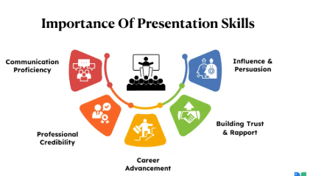
Why it is important
Its being used in the schools, colleges and working field
Its mainly used to share our thoughts as the image or the short format to the users or the audience

Slide 3



Basic features of power point
Slide
  Each page is called a slide
Layouts
  Different arrangements of texts & images
Designs
  Ready made design styles
Text formatting
  Formate slide , Alignment, bullet points

Slide 4
Design tricks learnt
Slide Master
  changes we did in the first slide will affect the whole slides
Color consistency
  For this we can use format background tricks
Font pairing
  Font changes→ Arrow below it.

Slide 5
Animation & Transition
I have learnt about “ FADE, FLY IN, AEROPLANE
Time and duration must be proper
TRANSITIONS
Its just about the push up , push down, like giving efforts to our edits

Slide 6

Smart art & charts
Smart art is mainly for changing simple bullet points into different style formats
Insert → smart art
Charts are used to show any statistics or any surveys
Insert → charts or chart icon

Slide 7
Takeaways
Use simple and elegant designs
Use images to grab the attention from user
Use animations to increase curiosity
Less texts more works

Slide 8
Thank you

